Slide 1
Hiring Process Analytics
Name :- Yash Shinde
Email :- yashpradeepshinde@gmailcom

Slide 2
TABLE OF CONTENT
Project Description
Approach
Tech Stack Used
Analysis
Hiring Analysis
Salary Analysis
Salary Distribution
Department Analysis
Position Tier Analysis
Insights
Conclusion & Result

Slide 3
PROJECT DESCRIPTION

Slide 4
PROJECT DESCRIPTION
This project involves Data Analysis for Hiring Process Optimization at a Multinational Company.
The hiring process is a pivotal aspect of any successful organization, and a renowned multinational company like Google, recognizes the significance of optimizing this process.
As a data analyst, I have been tasked with conducting a comprehensive data analysis of the company's hiring process.
My primary objective is to extract meaningful insights and actionable recommendations that will facilitate the company in conducting recruitment procedures and making well-informed decisions for future hiring endeavors.
In this project, I will be provided with a dataset containing detailed records of previous hires at company. The dataset encompasses essential information, such as candidate demographics, interview details, job types and other relevant hiring metrics.
Leveraging my expertise in data analysis, I will perform A Data-Driven Analysis of Enhancing Hiring Process Efficiency.

Slide 5
approach

Slide 6
approach
Firstly, go through the dataset to know more about the data, tables, columns and the rows.
Analyze the data given in the dataset to perform operations.
Then solve the questions using Excel formulas.
I will provide a detailed explanation of output along with the formula and visual charts & graphs.
I will perform my analysis using the following list of points.
Analysis
Hiring Analysis
Salary Analysis
Salary Distribution
Department Analysis
Position Tier Analysis

Slide 7
Tech stack used
Microsoft Excel
Microsoft PowerPoint

Slide 8
analysis
Hiring Analysis
Salary Analysis
Salary Distribution
Department Analysis
Position Tier Analysis

Slide 9
A. hiring analysis: The hiring process involves bringing new individuals into the organization for various roles. Let's Determine the gender distribution of hires. How many males and females have been hired by the company?
For finding total number of males and females have been hired by the company.
I first filtered the status column by selecting hired candidates.
Then filtered the “event_name” column by selecting Male and Female
Then created a bar chart on that to analyze the result.
event_name | Count of event_name
Female | 1856
Male | 2563

Slide 10
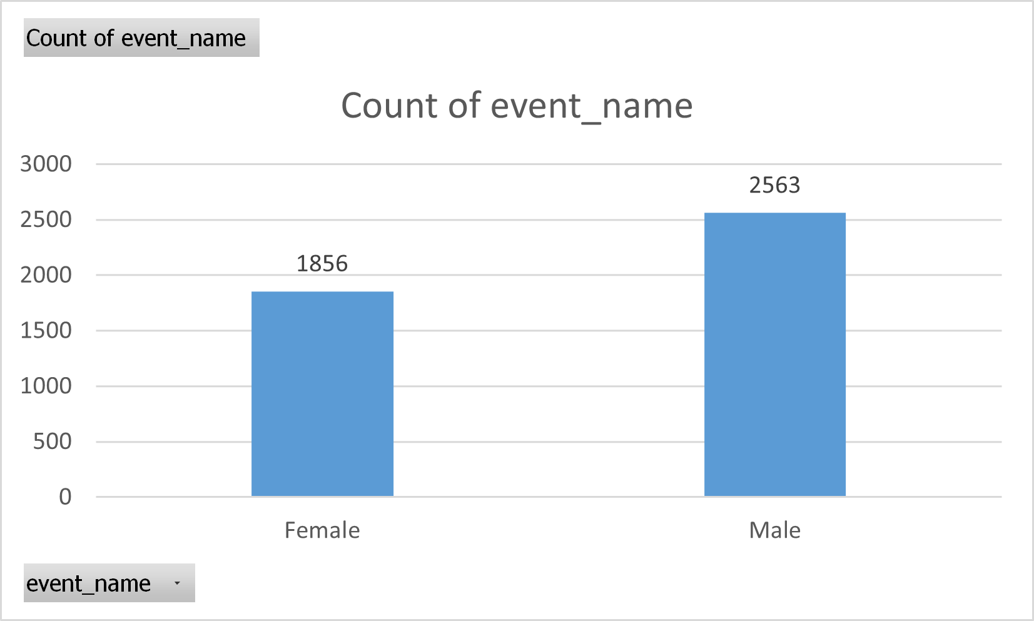

Slide 11
Average Salary : Adding all the salaries for a select group of employees and then dividing the sum by the number of employees in the group.
Steps to find the average salary offered in this company:-:
Step 1) I have removed outliers from the dataset.
( i.e. Salaries below 500 and Salaries above 100000)
Step 2) Then by using the “AVERAGE” formula of excel I have calculated the average salary.
Excel Formula :
=AVERAGE(G2:G7164)
Output/Result :
average_salary = | 49885.28117

Slide 12
Salary Distribution: Class intervals represent ranges of values, in this case, salary ranges. The class interval is the difference between the upper and lower limits of a class. Create class intervals for the salaries in the company. This will help you understand the salary distribution.
Steps to find the salary distribution offered in this company:-:
Step 1) I have selected “application id” and “offered salary” columns from the entire data.
Step 2) Then by selecting those columns created pivot table.
Step 3) Then grouped salaries by stepping of 5000.

Slide 13
Row Labels | Count of application_id
1-5000 | 295
5001-10000 | 382
10001-15000 | 360
15001-20000 | 372
20001-25000 | 348
25001-30000 | 363
30001-35000 | 331
35001-40000 | 379
40001-45000 | 414
45001-50000 | 367
50001-55000 | 388
55001-60000 | 362
60001-65000 | 340
65001-70000 | 358
70001-75000 | 348
75001-80000 | 386
80001-85000 | 356
85001-90000 | 355
90001-95000 | 325
95001-100000 | 334
Grand Total | 7163

Slide 14
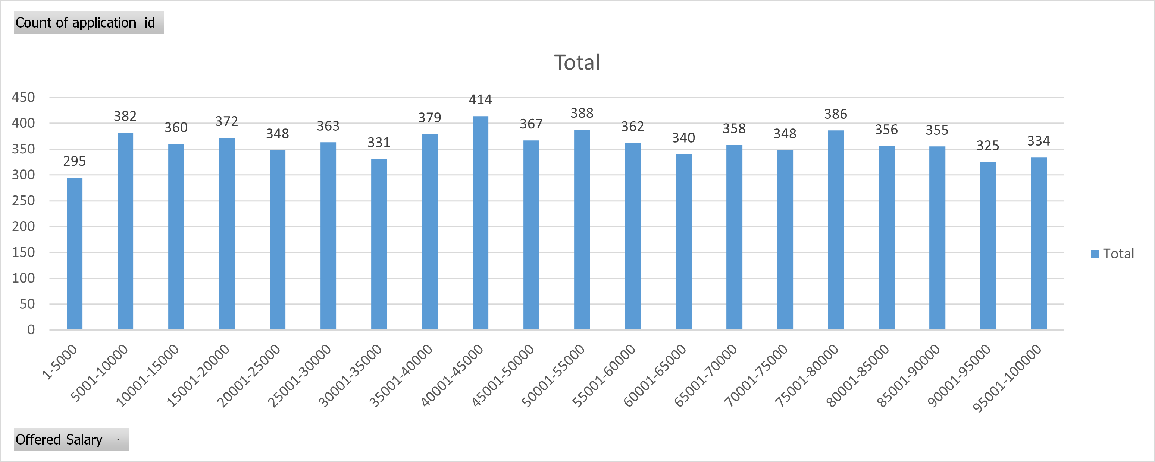

Slide 15
Departmental Analysis: Visualizing data through charts and plots is a crucial part of data analysis. Use a pie chart, bar graph, or any other suitable visualization to show the proportion of people working in different departments.
Steps to perform the departmental analysis:
Step 1) I have selected “application id” and “Department” columns from the entire data.
Step 2) Then created a frequency table of Departments.
Step 3) Then by selecting that frequency table created Pie-Chart and Bar-Graph.
Frequency Table :
Department | Count of Department
Operations Department | 2771
Service Department | 2053
Sales Department | 746
Production Department | 380
Purchase Department | 333
Marketing Department | 325
Finance Department | 288
General Management | 170
Human Resource Department | 97
Grand Total | 7163

Slide 16
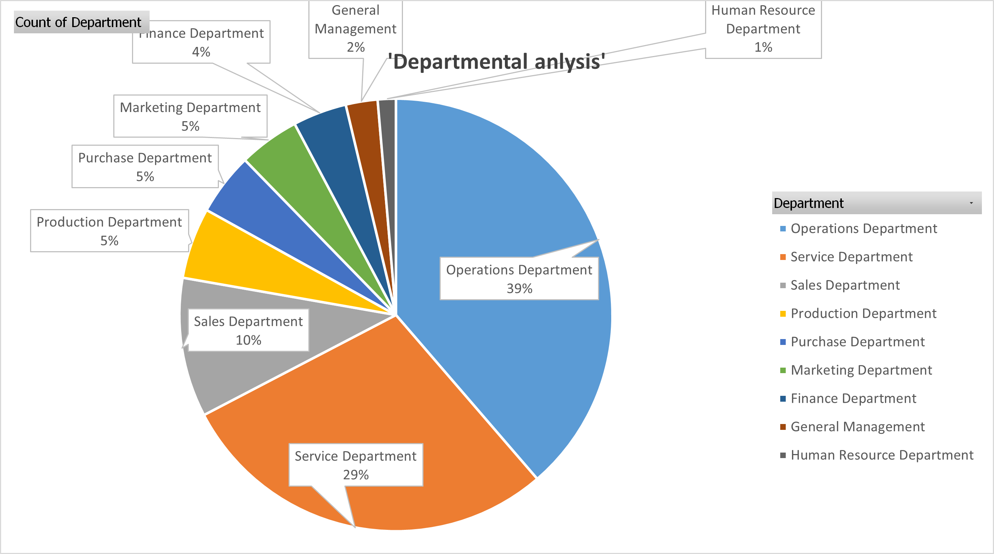
Pie Chart:

Slide 17
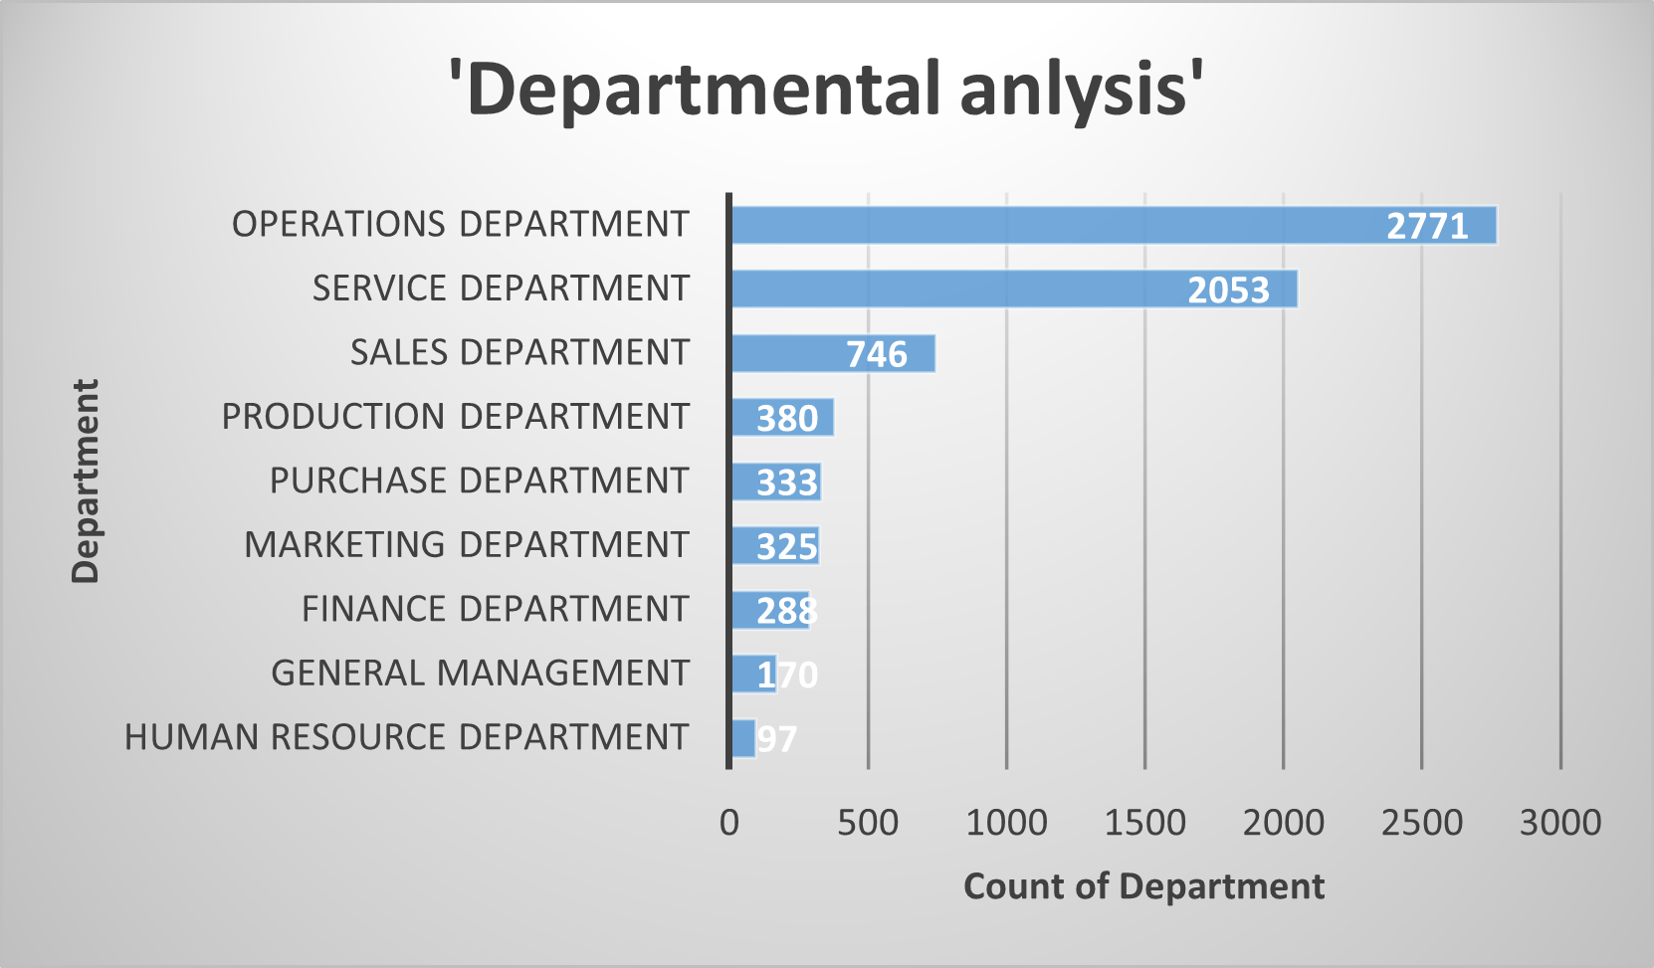
Bar Graph:

Slide 18
Departmental Analysis: Companies typically have various levels or tiers for different positions. Create a chart or graph to visualize the distribution of positions across these tiers, aiding in comprehension.
Frequency Table :
Post Name | Count of Post Name
c9 | 1792
c5 | 1747
i7 | 980
i5 | 786
i6 | 527
b9 | 462
c8 | 320
c-10 | 232
i1 | 222
i4 | 87
m6 | 3
n6 | 1
n10 | 1
n9 | 1
- | 1
m7 | 1
Grand Total | 7163
Steps to perform the Position Tier Analysis:
Step 1) I have selected “Post Name” column from the entire data.
Step 2) Then created a frequency table of Post Name.
Step 3) Then by selecting that frequency table created Pie-Chart and Bar-Graph.

Slide 19
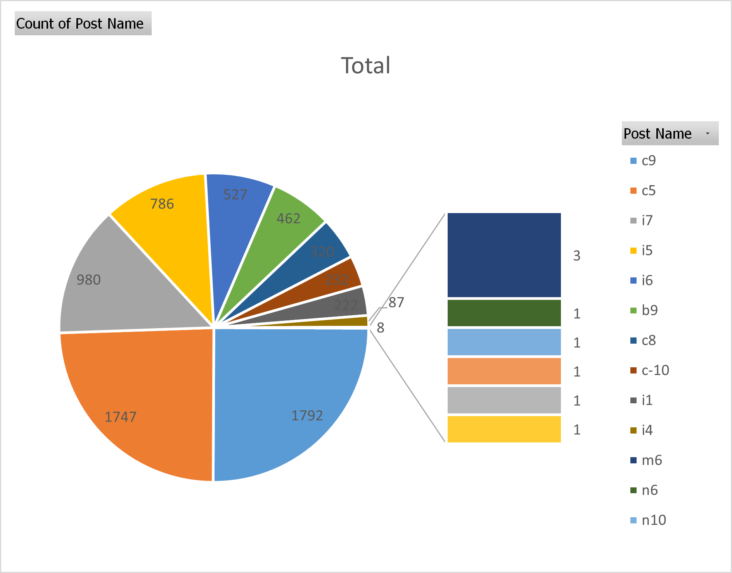
Pie Chart:

Slide 20
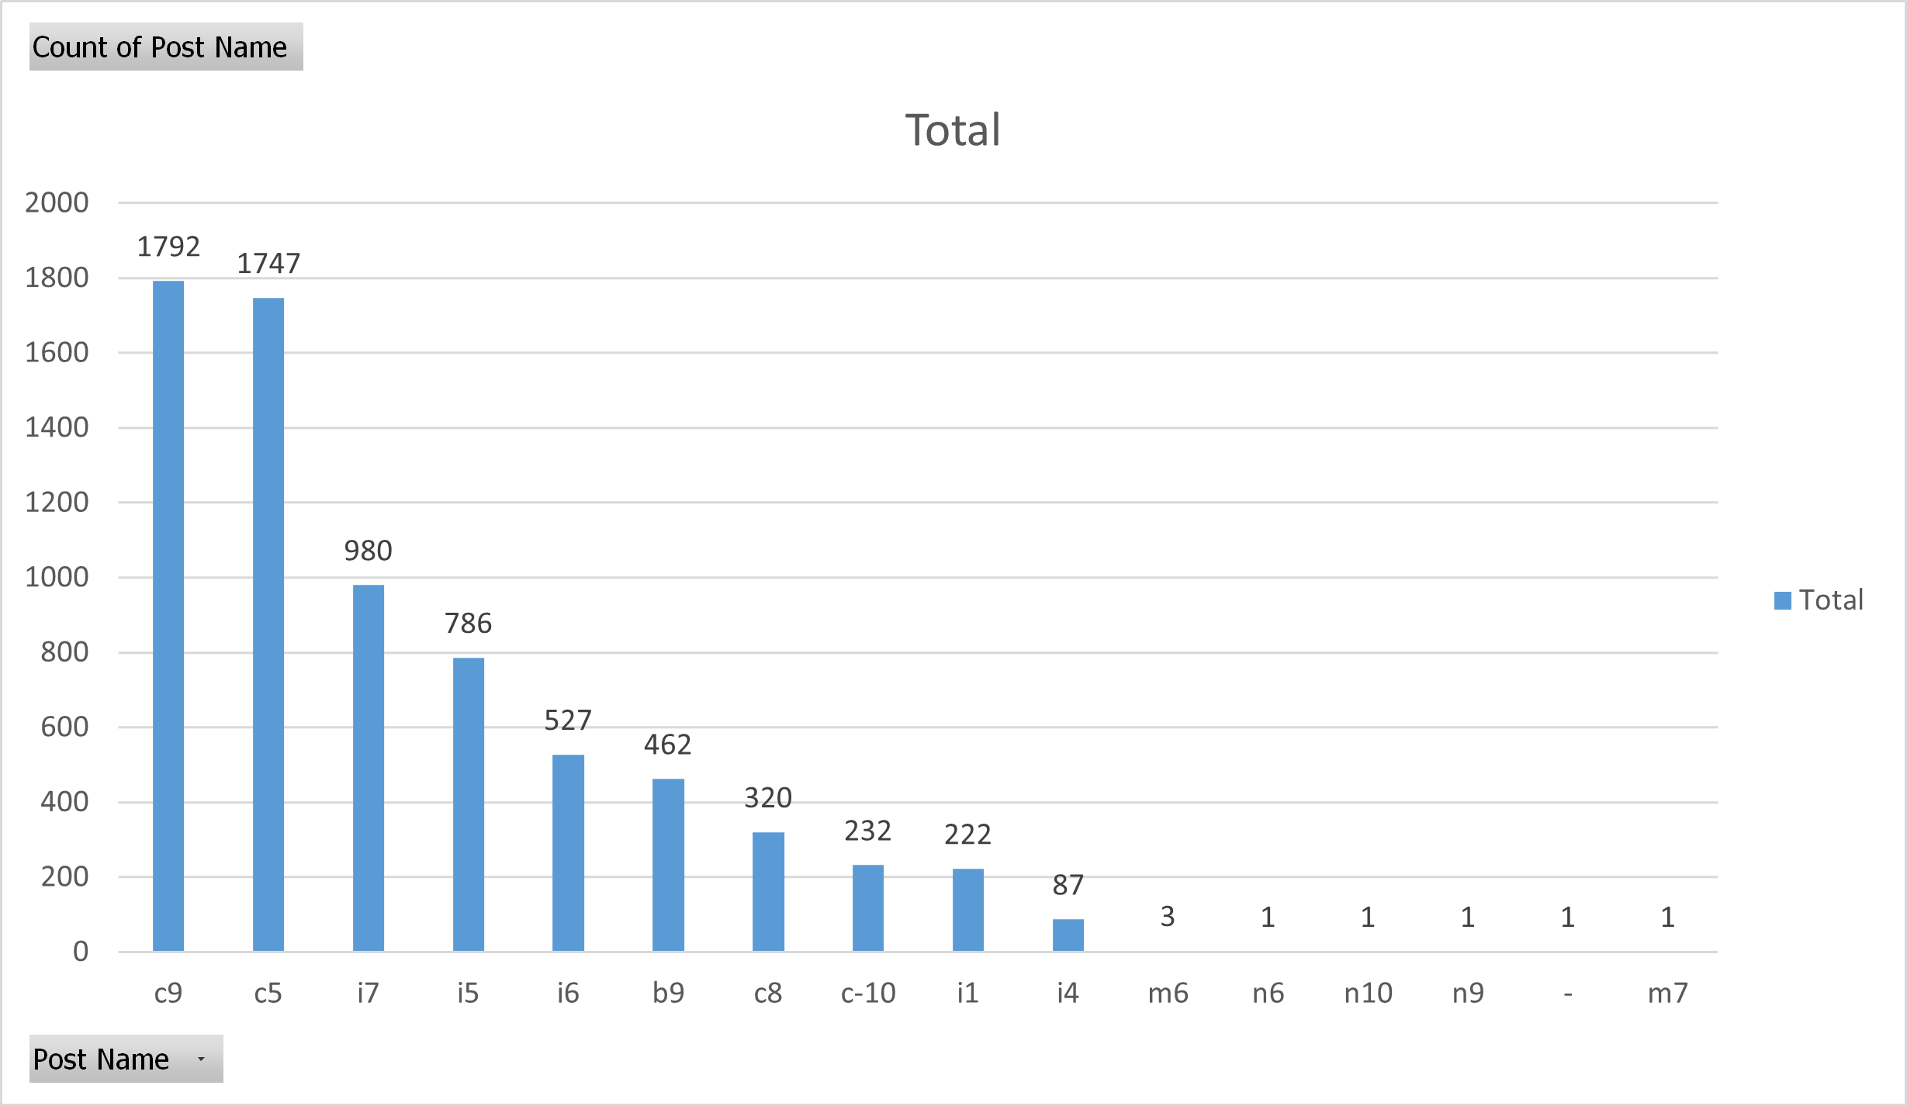
Bar Graph:

Slide 21
Conclusion

Slide 22
Conclusion
Thus, I have explored provided Statistics Dataset of the company hiring process.
Given key findings and all meaningful trends or patterns discovered.
I have learned to use Excel to analyze the dataset.
I have learned to gain insights by using Excel Formulas.
All the respective Charts and their output is attached to this report.
GitHub Repository and drive links are given as follows.
GitHub Repository:- https://github.com/ShindeYash/Hiring_Process_Analytics
Drive Link:- https://drive.google.com/drive/folders/1vbCrkbPZpD0_W1uGuV_d_QVAd38QBK7G?usp=sharing

Slide 23
THANK YOU
Yash Shinde​
yashpradeepshinde@gmail.com

